Slide 1
CS5950 – Android Development Searchable Activities
By Leonardo Monteiro Costa
WESTERN MICHIGAN UNIVERSITY, KALAMAZOO - MI

Slide 2
Introduction
This presentation shows the step-by-step to create a Searchable Activity
The example application is supposed to show a list of countries and its respective capital cities.
Once the user searches for a country in the search box, it filters the country amongst the data set.
This presentation will give just a brief comment about the additional features of the application such the database handling and the lifecycle of the fragments or activities, focusing more on the steps to make the application Searchable.

Slide 3
Model and GUI
Our model consists in a class Country, a DatabaseHelper to handle the SQLite database and a CountryManager to bridge the Country class to the DatabaseHelper.
Our GUI consists on a activity MainActivity that extends SingleFragmentActivity and show the CountryFragment, a fragment class that show a list of countries and its respective capital cities.

Slide 4
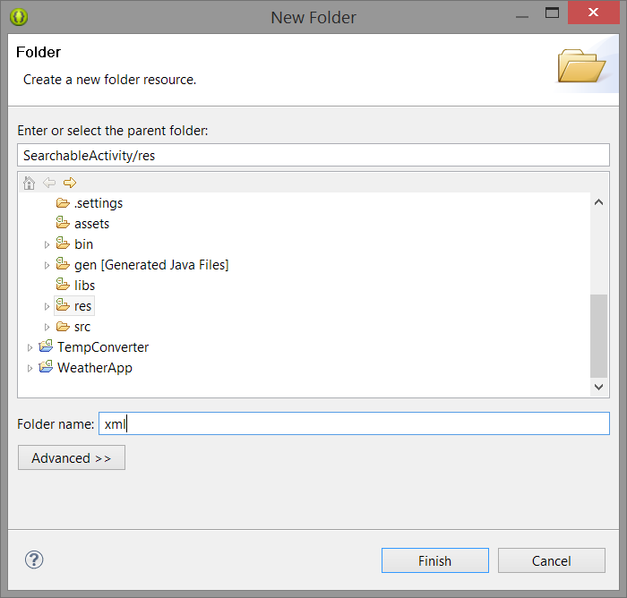
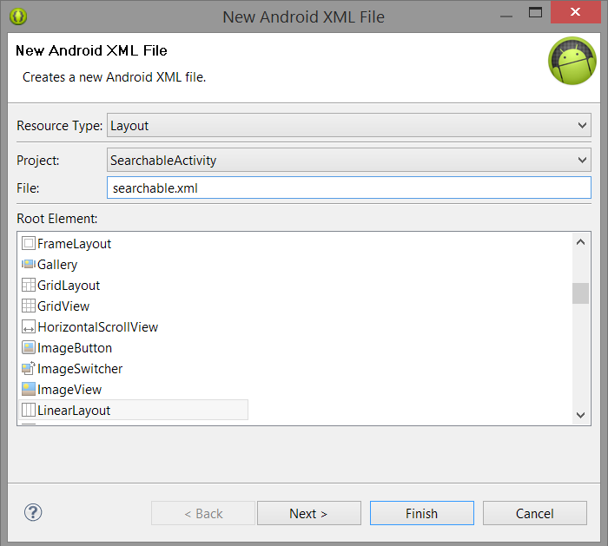
Creating the Search Interface (Part I)
We create a folder called xml in the res folder
Then, create a xml file to represent
The search.

Slide 5
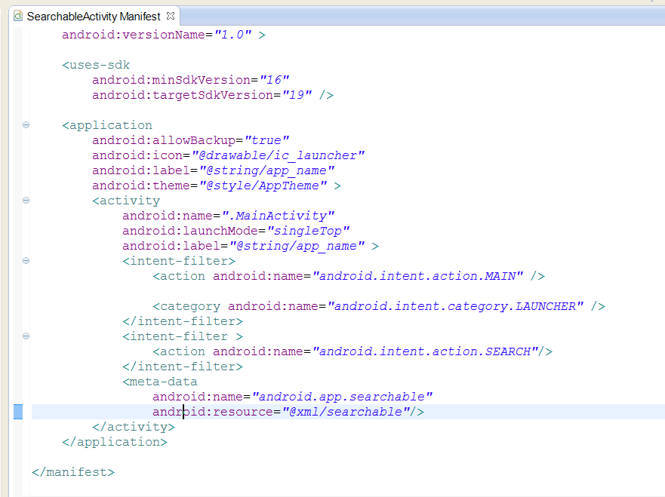
Creating the Search Interface (Part II)
We edit the Manifest file to appear like as in the code at left:
A intent filter is added to allow the Search.

Slide 6
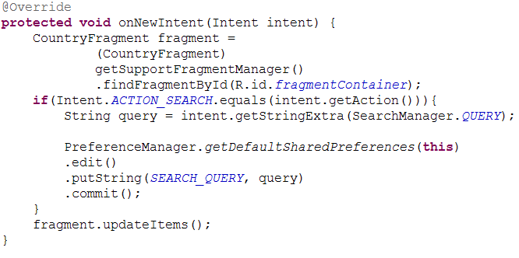
Creating the Search Interface (Part III)
In the MainActivity we override the method onNewIntent to whenever receive a new intent search, refresh the CountryFragment.

Slide 7
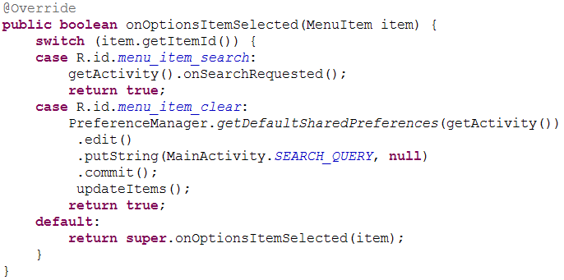
Creating the Search Interface (Part IV)
The CountryFragment inflates a menu containing a search box that is managed by the onOptionsItemSelected method. As the search is made it call the method updateItems of the Fragment.

Slide 8
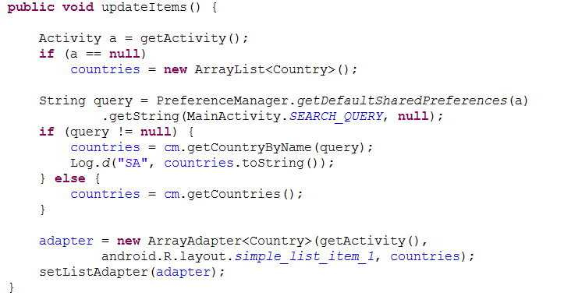
Creating the Search Interface (Part V)
In the CountryFragment we set a updateItems method that retrieves the query and return the result as a filter in the list

Slide 9
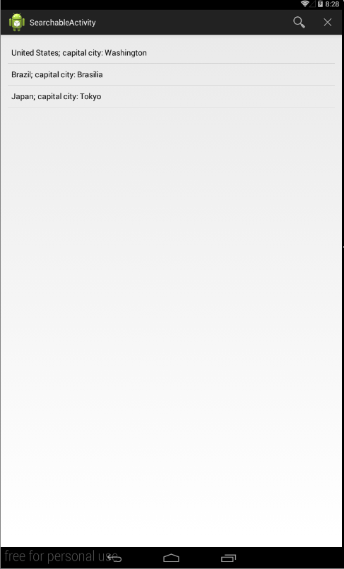
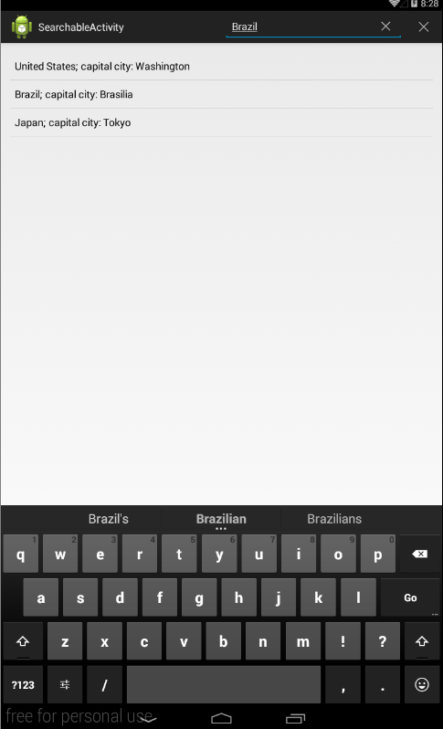
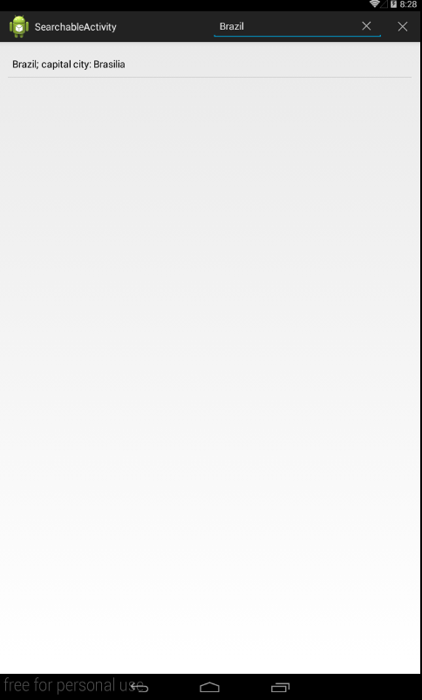
Demo

Slide 10
References
http://developer.android.com/guide/topics/search/search-dialog.html
Phillips, B., & Hardy, B. (2013). Android Programming: The Big Nerd Ranch Guide. Pearson Education.

